Slide 1
BSc Ist Year
PAPER CODE: CHEM 102 TH
SECTION B: SOLIDS
TOPIC:ELEMENTS OF SYMMETRY

Slide 2
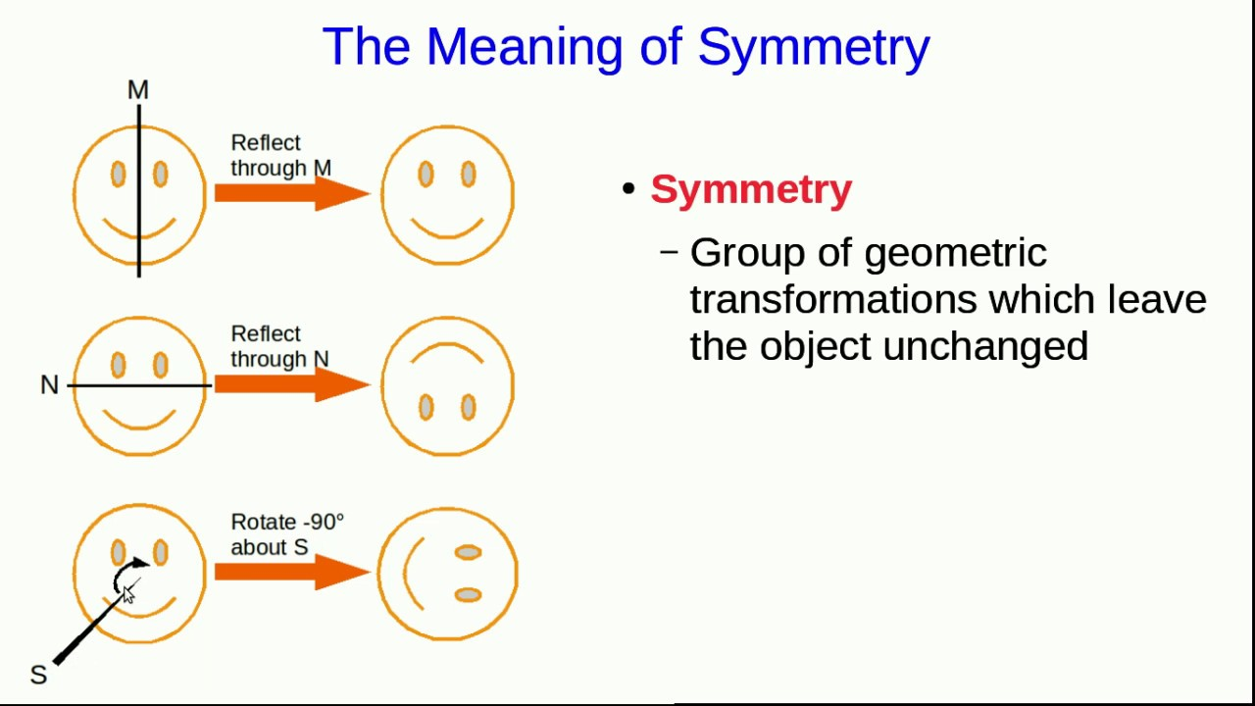
Definition and types
The geometrical entity like point,plane,axis with respect to which a symmetry operation may be carried out is called symmetry element.
Types:
Plane of symmetry
Axis of symmetry
Centre of symmetry
Rotation reflection axis
Rotation inversion axis.
Note: Symmetry operation is an operation performed around a line,plane or point on a body such that it brings the ame or similar appearance of the body after the operation.

Slide 3
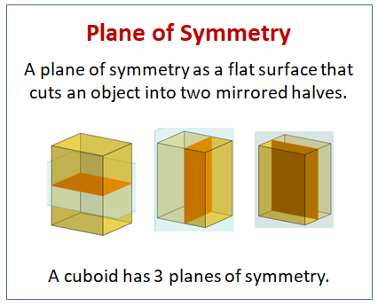
Plane of symmetry
It is defined as an imaginary plane passing throught the centre of the crystal which divides the crystal into two equal halves such that one part is the mirror image of the other part.They are also called mirror planes.

Slide 4
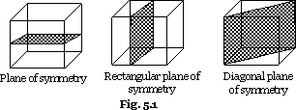
Types of plane of symmetry
RECTANGULAR PLANE :Situated in middle and oppsite to parallel faces of crystal.As faces are 6 ,so these planes are 3.
DIAGONAL PLANES:They touch the opposite edges.As there are 12 edges ,so these planes are 6.

Slide 5
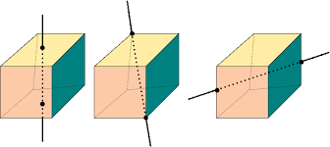
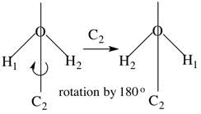
Axis of Symmetry Cn
It is an imaginary line passing through the centre of crystal about which the crystal may be rotated such that it presents exactly the same or similar appearance more than once in one complete rotation of 360
Types
Two fold axis of symmetry C₂(Rotation by 180)
Three fold axis of symmetry C₃(Rotation by 120)
Four fold axis of symmetry C₄ (Rotation by 90)

Slide 6
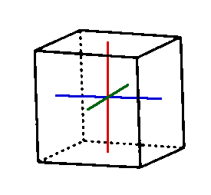
Centre of symmetry
Opposite faces can be seen by the three coloured lines
It is an imaginary point within the crystal such that any line drawn through it intersects the opposite faces of the crystal at equal distances.
There is only one possible centre of symmetry for a crystal.
The point of intersection of the three lines at the centre of cube is centre of symmetry.

Slide 7
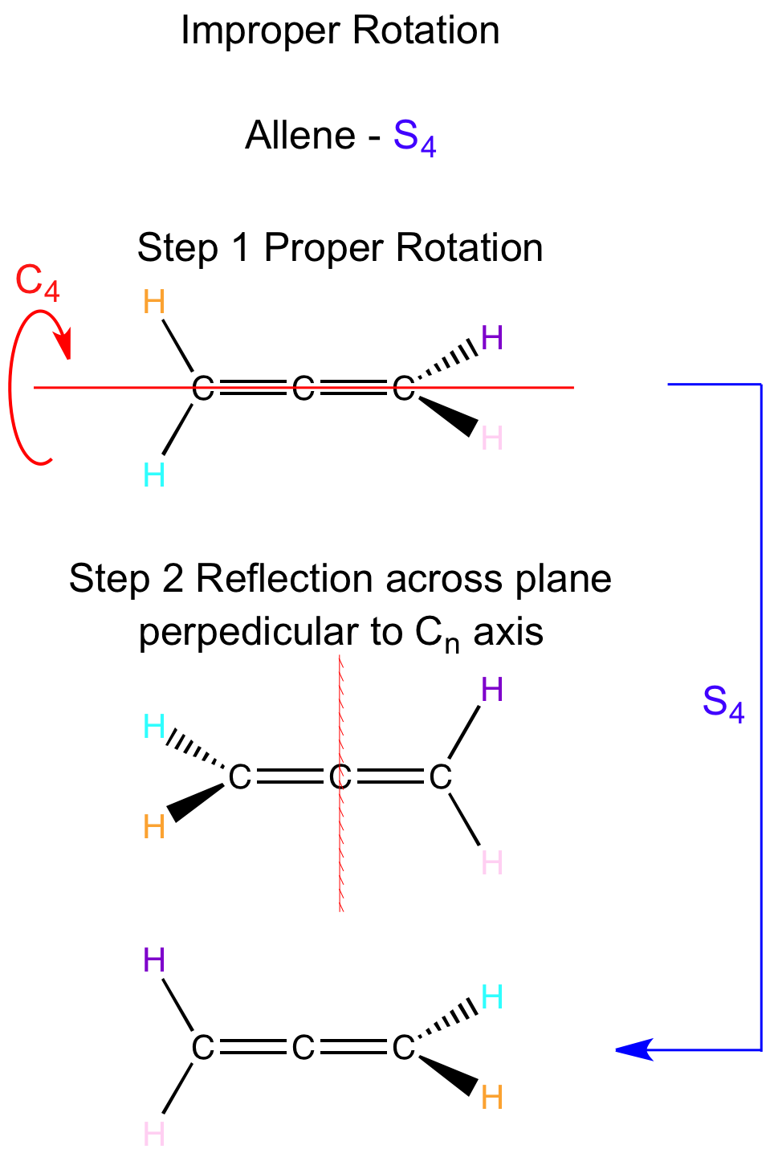
Rotation reflection Axis of symmetry
When a crystal is rotated through n fold axis of symmetry followed by reflection in a plane perpendicular to the axis ,then the axis is called n fold rotation reflection axis of symmetry.The new configuration is not identical but enantiomorphous.
It is denoted by symbol Sn.

Slide 8
Rotation inversion axis of symmetry
When rotation about n fold axis of symmetry is followed by the inversion through centre of symmetry ,the axis is called rotation inversion axis of symmetry.The new configuration is not identical but enantiomorphous.
The rotation which gives rise to identical configuration is proper rotation and the one which gives rise to enantiomorphous configuration is improper rotation.

Slide 9
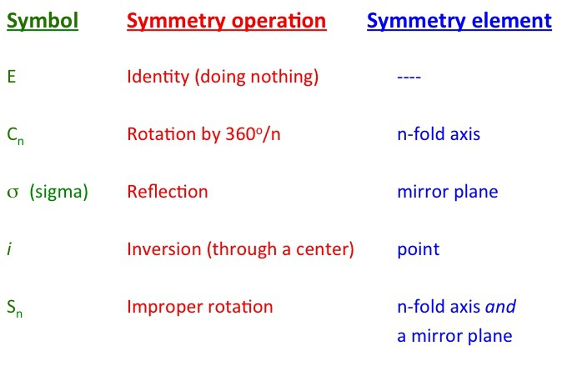
Symmetry elements and operations

Slide 10
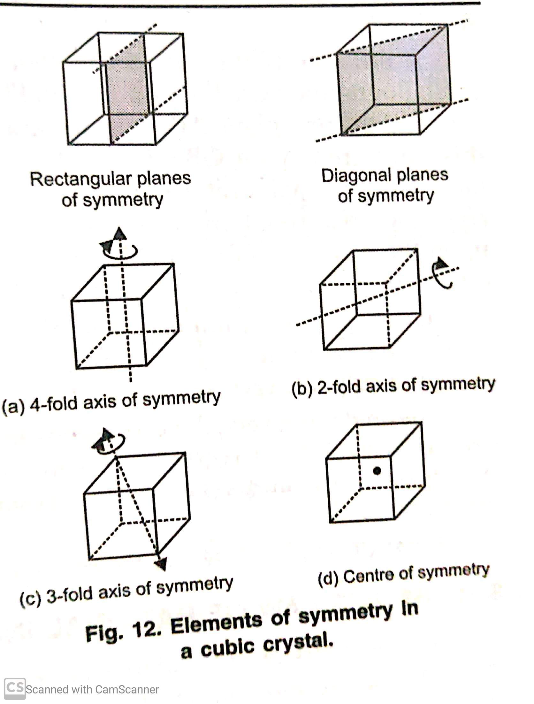
THE LAW OF SYMMETRY
The law states that the crystals of the same substance always possess same elements of symmetry
Example : A cubic crystal always has 23 elements of symmetry
Rectangular plane of symmetry=3
Diagonal planes of symmetry=6
Four fold axis of symmetry=3
Three fold axis of symmetry =4
Two fold axis of symmetry=6
Centre of symmetry=1

Slide 11
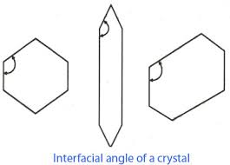
Law of constancy of interfacial angles
The angles between the corresponding faces of the crystal called the interfacial angles are always same for a given substance and are independent of the shape and size of the crystal.
For sodium chloride crystal this angle is 90.
Interfacial angles are measured with help of instrument called goniometer.

Slide 12
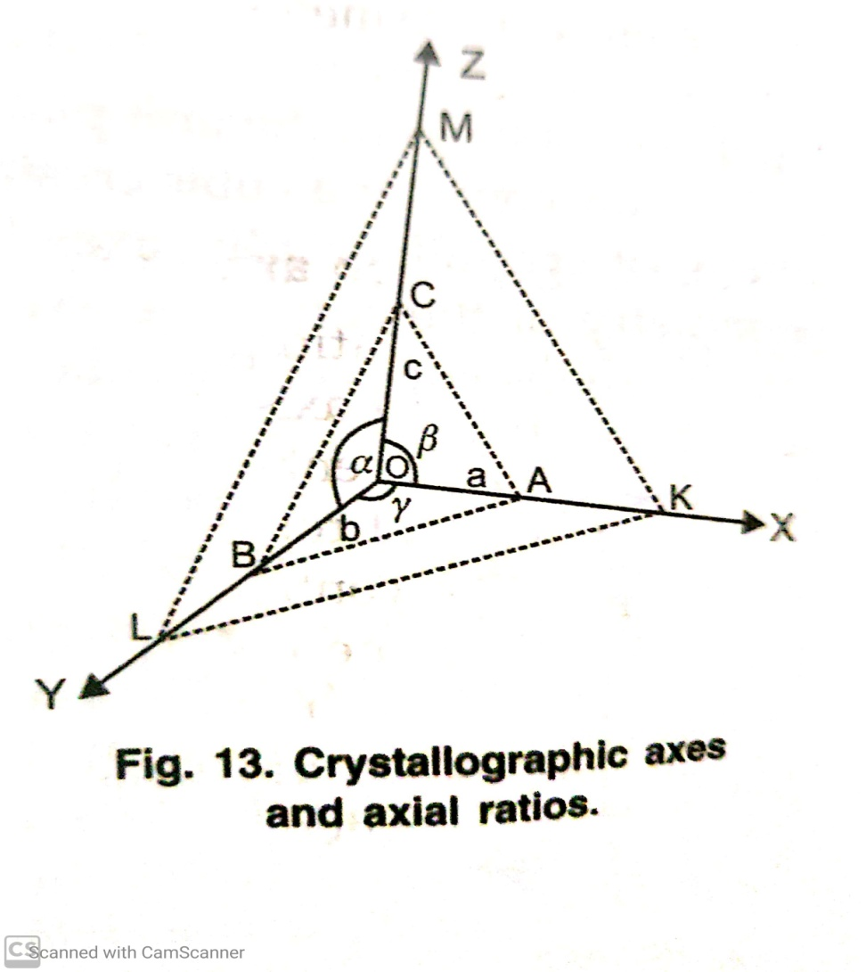
Huays Law of rationality of indices
It deals with the geometry of crystal which can be specified by crystallographic axes.Crystallographic axes are the three lines which coincide with or are parallel to the edges of a crystal and meet at a point.

Slide 13
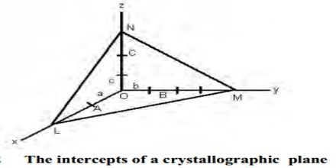
Huays Law…
According to this law the intercepts of any plane or face of a crystal on the crystallographic axes are:
Equal to the unit intercepts (a,b,c)
Or some simple whole number multiple of them :la;mb;nc wher l,m,n are simple integers.
Or one or two intercepts may be infinity when crystal planes are parallel to one or more axes.

Slide 14
Some practice questions
A five fold axis of symmetry cannot be present in any of the crystal.Comment
What is interfacial angle?
Describe law of indices?
The total number of symmetry elements in a cube are…………..
Interfacial angles can be measured with the help of…………………
How many faces and edges are present in a cube?
H₂O has C₂ axis of symmetry (T/F)
What do you mean by S₂ symmetry?
https://www.mathsisfun.com/geometry/vertices-faces-edges.html
Try to understand Eulers Formula as applied to crystals

Slide 15
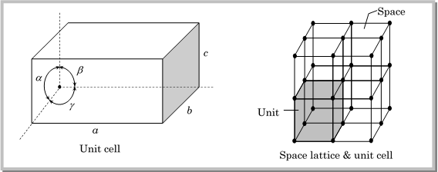
THANX WITH A NOTE THAT KINDLY REVISE THE TOPICS LIKE UNIT CELL,LATTICE ,TYPES OF BRAVAIS LATTICE FROM YOUR 12TH CLASS BOOKS.

